Slide 1
Clustering Analysis on Les Misérables Social Network
DUNDA, Gerry Windiarto Mohamad
20491372
MATH 5473 Final Project

Slide 2
Outline
Introduction
Prior Knowledge of the dataset
Methodology
Results
Conclusion

Slide 3
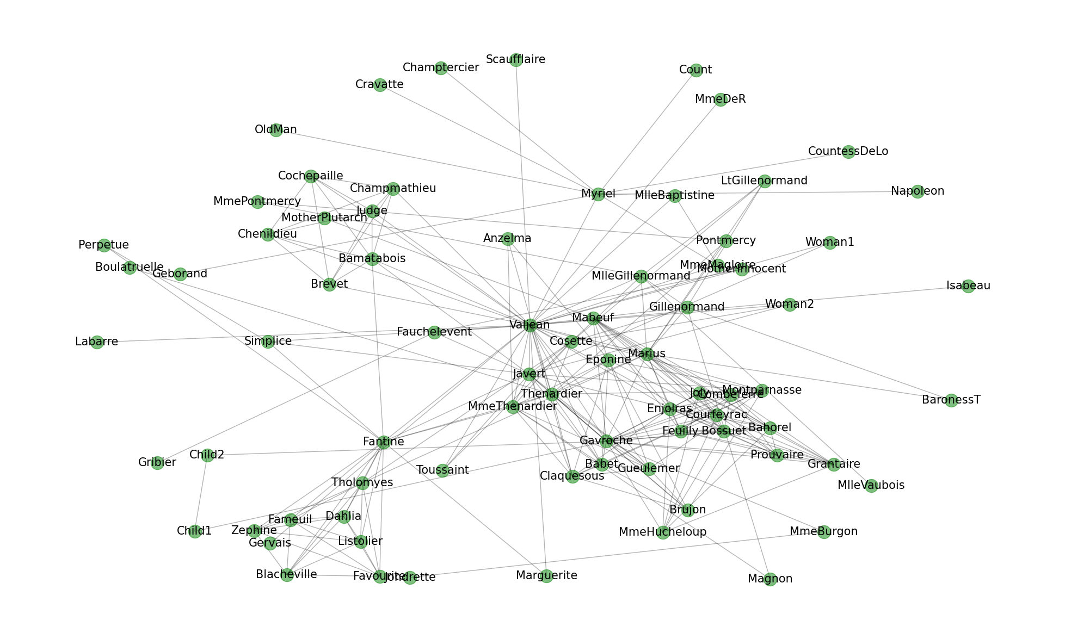
Introduction
Les Misérables Social Network Dataset
Suppose that we do not read the novel and we have complex network of characters with edge as co-occurrence in the scene.
Where should we start to gain interesting insight on the story?

Slide 4
Prior Knowledge of Les Misérables
Javert is the inspector trying to capture ex-convict Valjean
Cosette and Marius are relatives to Valjean

Slide 5
Methodology
Biclustering methods
- Bipartition technique based on Fiedler
- Normalized Ncut
- Transition path theory
Multi-clustering methods
- Modified Ncut
- Louvain community detection

Slide 6

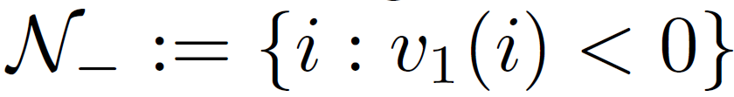
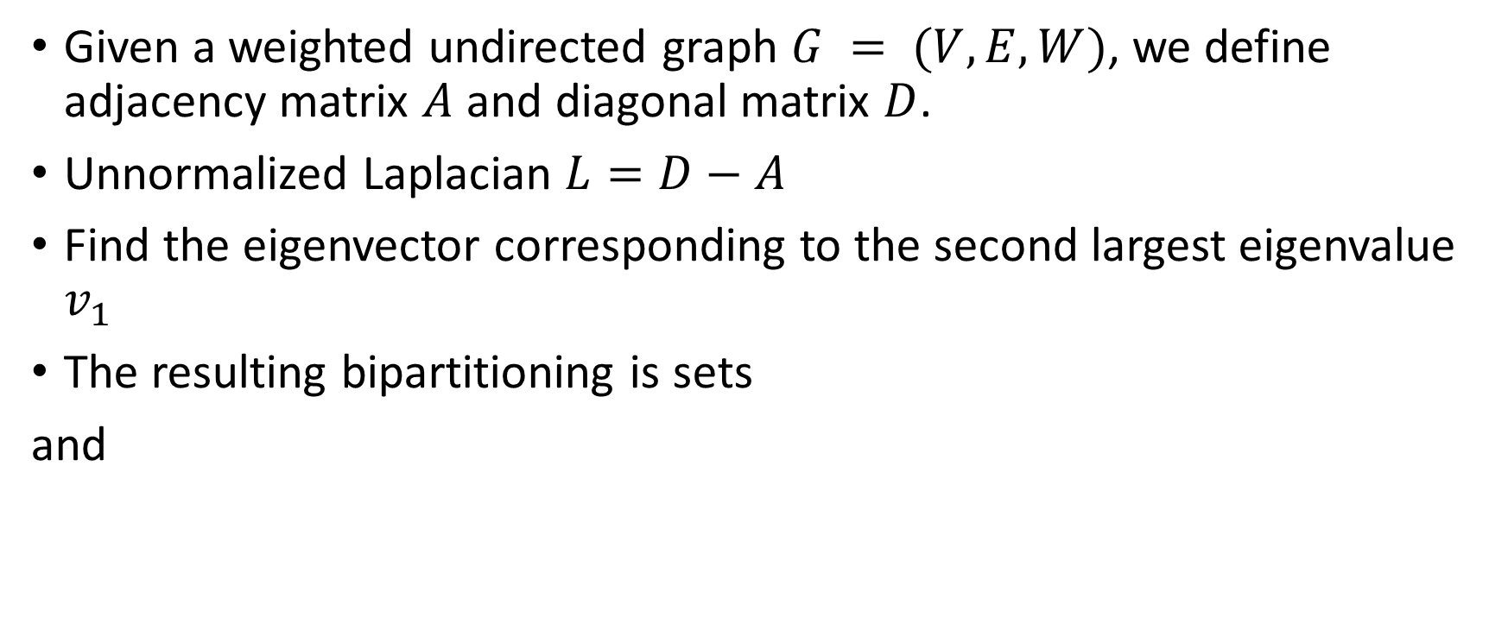
Bipartition Technique Based on Fiedler
Given a weighted undirected graph $G = (V,E,W)$, we define adjacency matrix $A$ and diagonal matrix $D$.
Unnormalized Laplacian $L=D−A$
Find the eigenvector corresponding to the second largest eigenvalue $v_{1}$
The resulting bipartitioning is sets
and

Slide 7

Normalized Ncut
Similar to the previous method except we consider the normalized Laplacian $ℒ=D^{−\frac{1}{2}}LD^{\frac{1}{2}}$.
The original idea is to minimize the sum of weights across two different groups

Slide 8

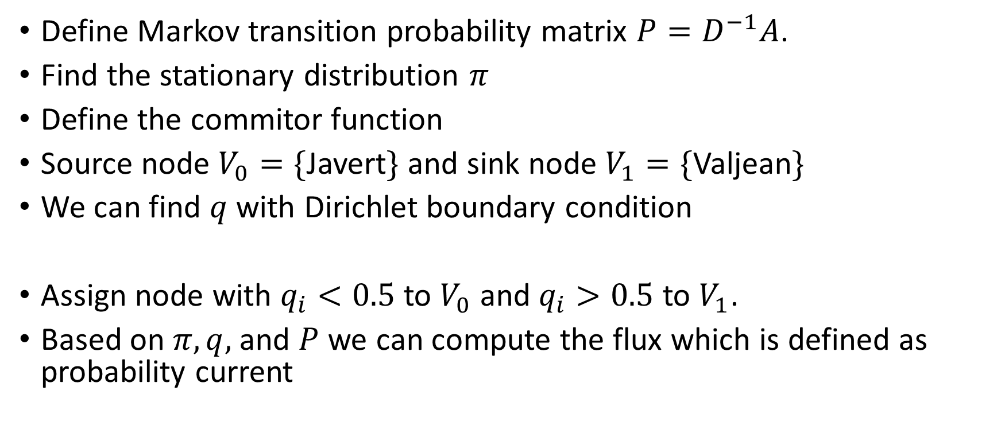
Transition Path Theory
Define Markov transition probability matrix $P=D^{−1}A$.
Find the stationary distribution $π$
Define the commitor function
Source node $V_{0}=\{$Javert$\}$ and sink node $V_{1}=\{$Valjean$\}$
We can find $q$ with Dirichlet boundary condition
Assign node with $q_{i}<0.5$ to $V_{0}$ and $q_{i}>0.5$ to $V_{1}$.
Based on $π,q,$ and $P$ we can compute the flux which is defined as probability current

Slide 9

Modified Ncut
Find the eigenvectors of $P$ and perform descending sort based on the eigenvalues
Perform $k$-means clustering on the row vectors of $[x_{2},…,x_{k}]$

Slide 10

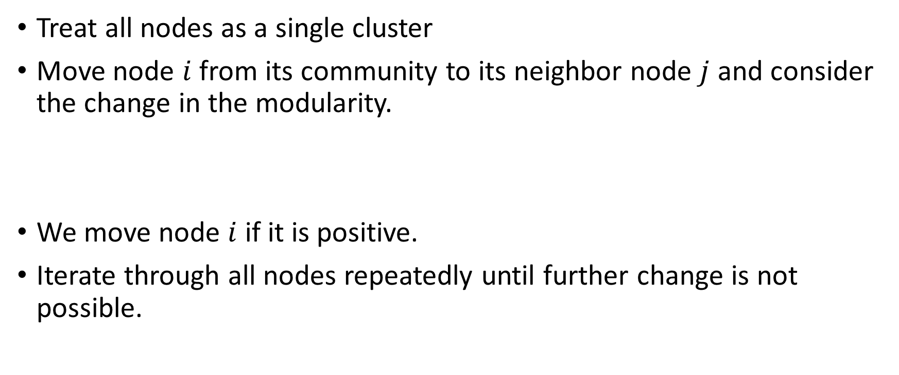
Louvain Community Detector
Treat all nodes as a single cluster
Move node $i$ from its community to its neighbor node $j$ and consider the change in the modularity.
We move node $i$ if it is positive.
Iterate through all nodes repeatedly until further change is not possible.

Slide 11
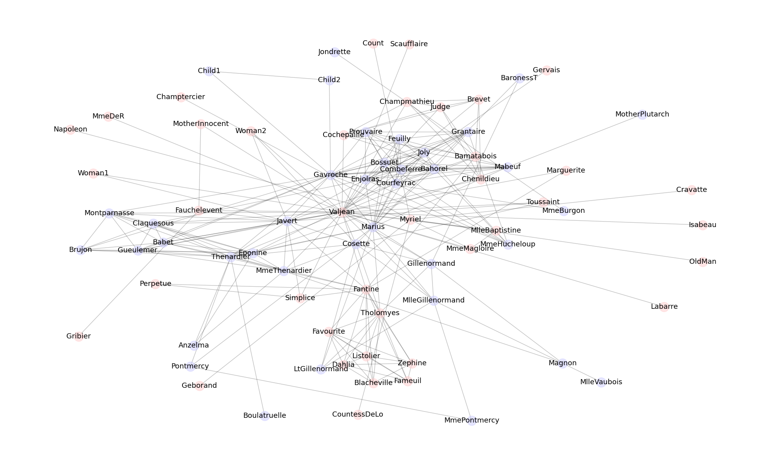
Results for Fiedler

Slide 12
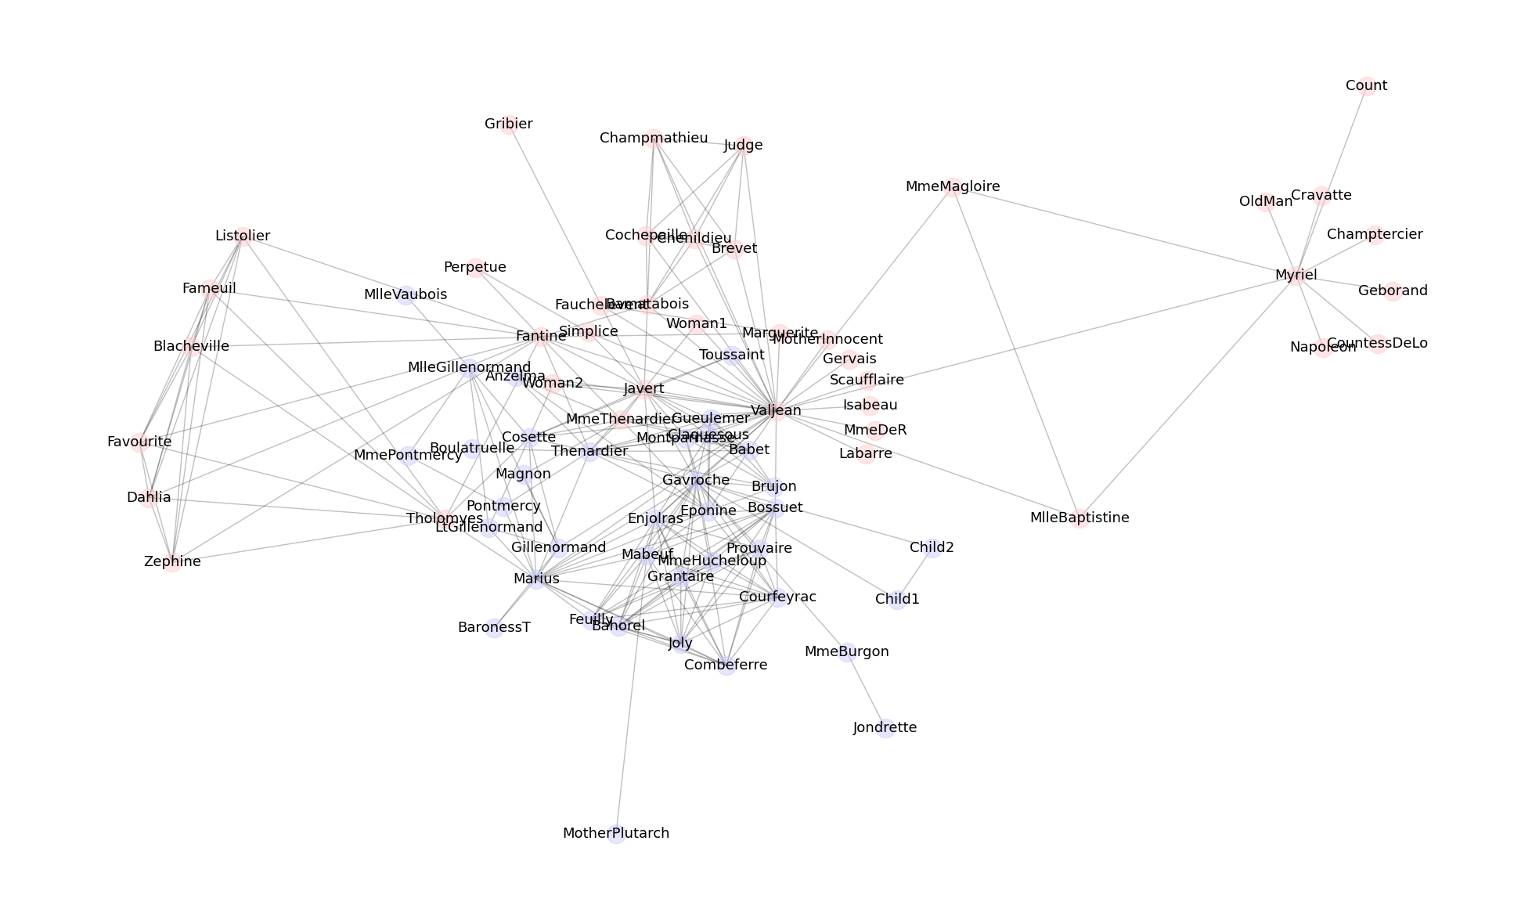
Normalized Ncut Result
Less intuitive than Fiedler

Slide 13
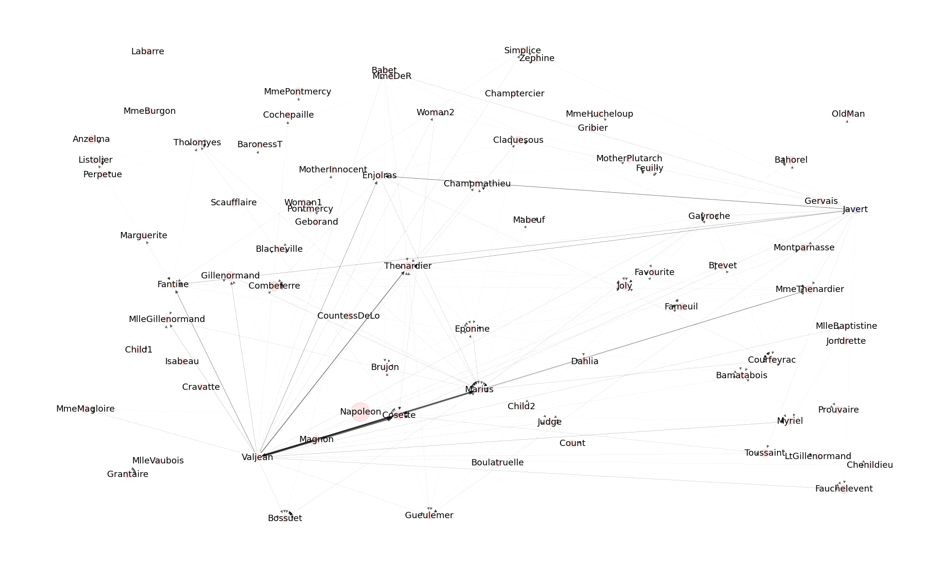
Transition Path Theory Result
We discover a large flux from Cosette and Marius to Valjean node
both Valjean and Javert point towards Enjolras and Thénardier, suggesting intermediary role in the story

Slide 14
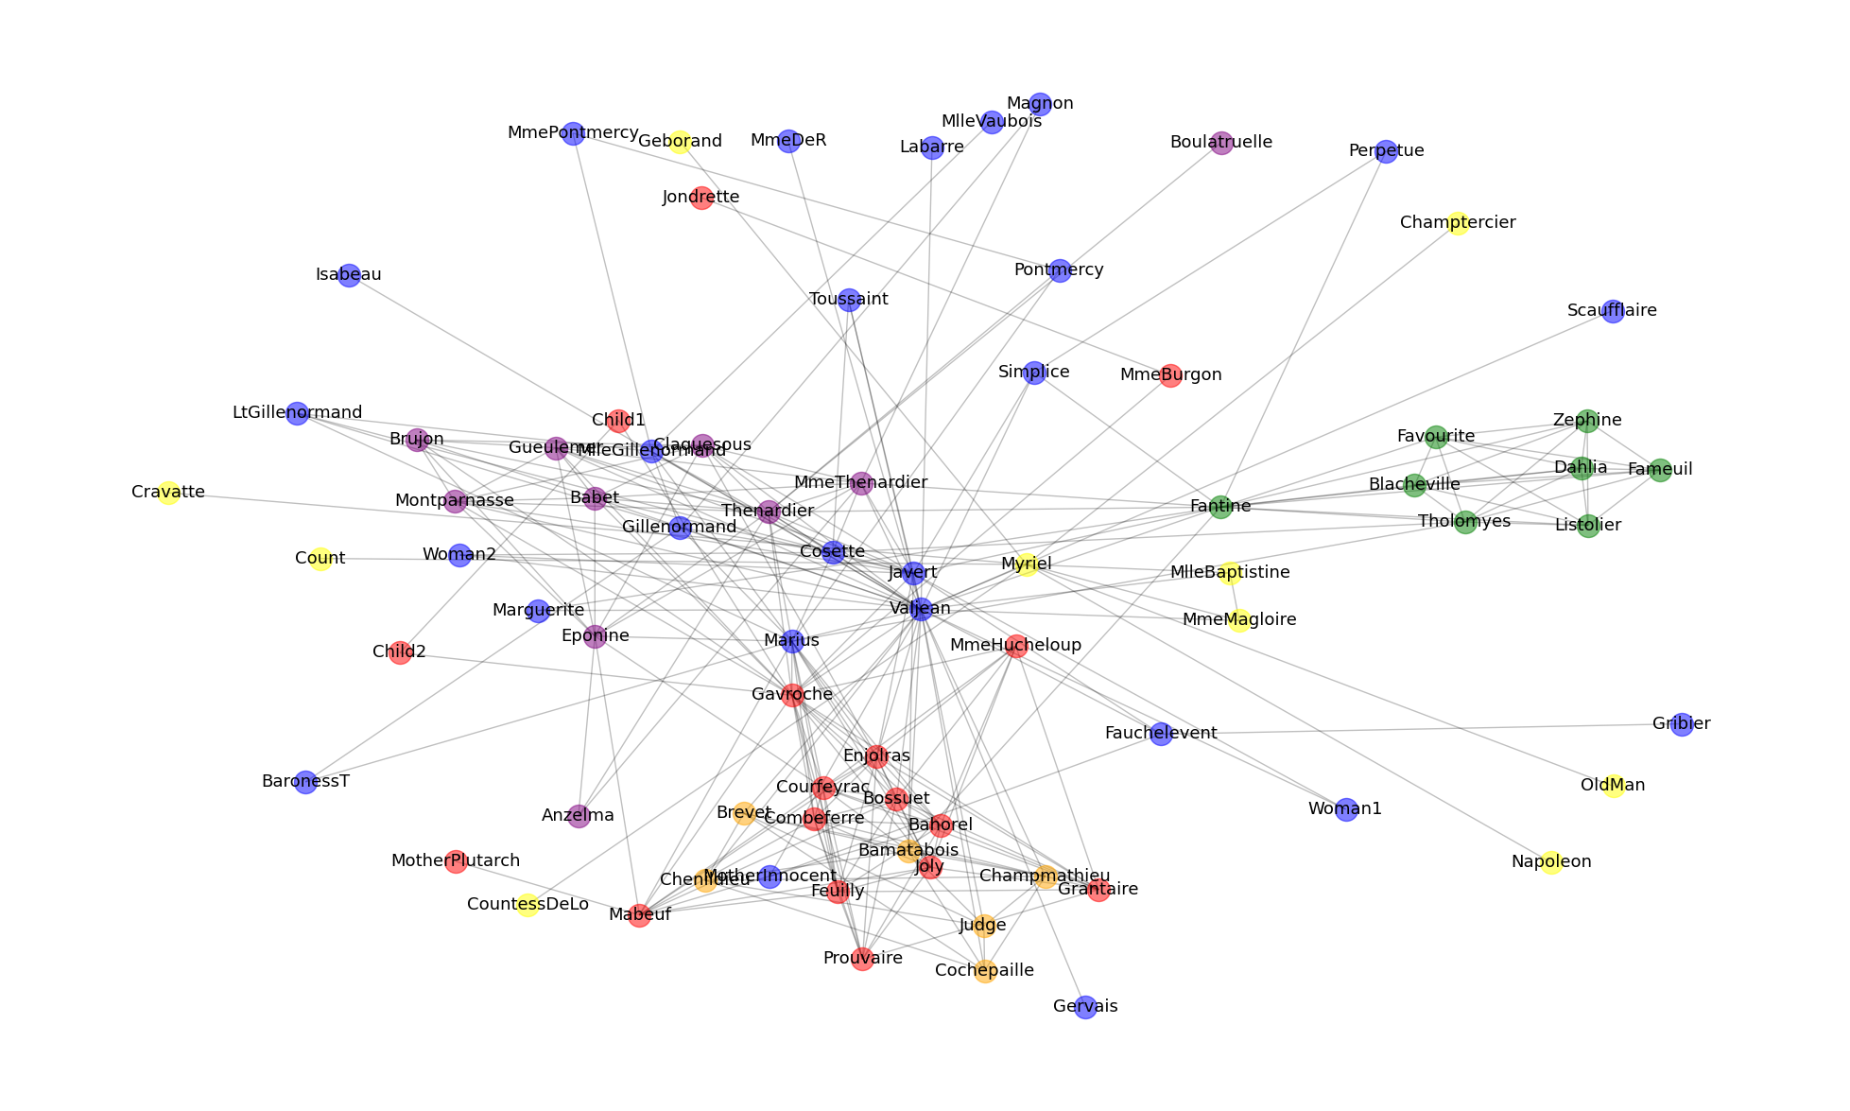
Modified Ncut Result
Valjean and Javert are in the same community, along with his relatives
Gavroche good friends are Enjolras, Grantaire, Joly, Combeferre, and Courfeyrac
Zephine, Dahlia, and Favourite are members of Fantine’s group
Side characters are in yellow
Orange community is prisoners relationship

Slide 15
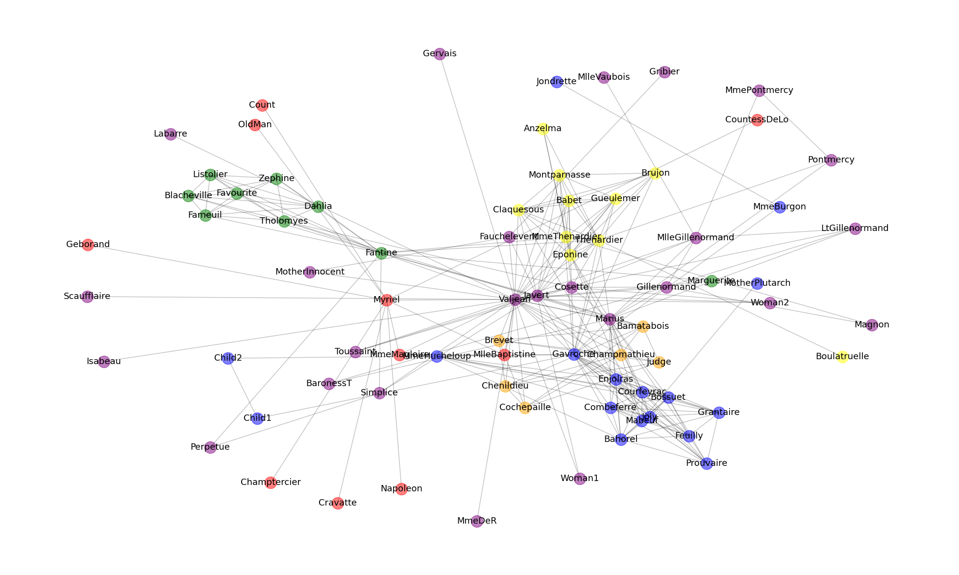
Louvain Result
Similar to modified Ncut except Marguerite. She is in Fantine’s community.
In fact, Marguerite is closer to Fantine as Marguerite gave Fantine lessons on poverty

Slide 16
Conclusion
Biclustering methods gives little insight about Les Misérables dataset. However, TPA gives remarkable insight about the intermediary characters that contribute important plot in the story.
Multi-clustering methods give more intuitive insights about the communities in the story and Louvain gives more plausible result.

